Slide 1
Implementation of Selective Compliance Assembly Robot Arm
(SCARA)
GROUP 6
(S6 B.Tech In Robotics And Artificial Intelligence)
Presented By:
Aswathi Anil-11
Amisha Sarup A-08
Fatimath Shana AP-19
Ayisha Ziya-14
DEPARTMENT OF ELECTRONICS AND COMMUNICATION ENGINEERING

Slide 2
CONTENTS
INTRODUCTION
OBJECTIVES
DESIGN PARAMETERS
CAD MODEL
STRUCTURAL PARAMETER
DEGREE OF FREEDOM
MATERIALS USED
MECHANICAL PARAMETERS
POWER REQUIREMENT
CONTROL SYSTEM
DETAILS OF COST INVOLVE

Slide 3
INTRODUCTION
SCARA robots are suitable for automated writing and drawing due to their high speed and planar accuracy.
Their horizontal compliance allows smooth motion, while vertical rigidity maintains consistent pen pressure.
They are useful for tasks such as form filling, labeling, and simple pattern or circuit drawing.
Automation reduces human fatigue and improves repeatability and consistency.
Programmable operation enables continuous and precise writing performance.

Slide 4
OBJECTIVES
Design and develop a 4-DoF SCARA (Selective Compliance Assembly Robot Arm) capable of writing text and patterns on a paper surface with high accuracy and repeatability.

Slide 5
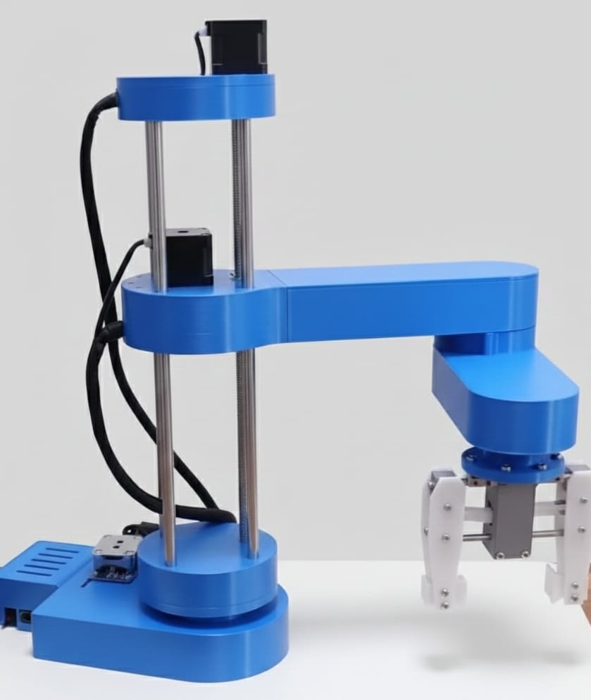
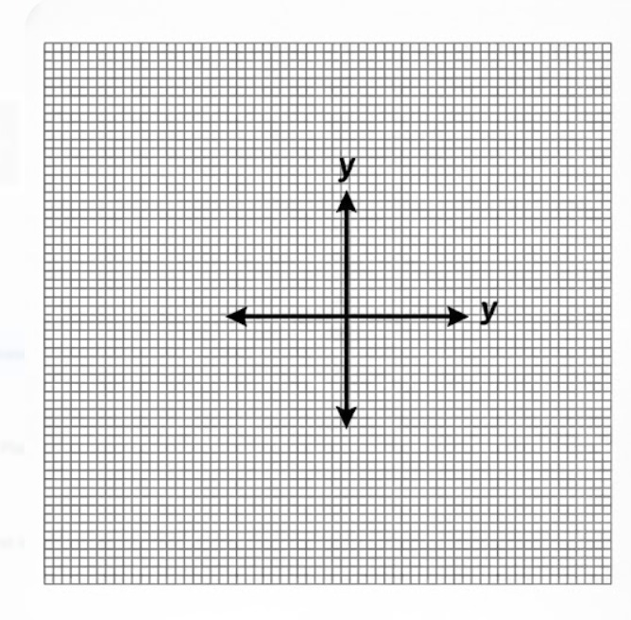
DESIGN PARAMETERS
WORKSPACE
The SCARA robots horizontal reach and vertical stroke enable precise pattern drawing or writing tasks within a writing surface(A4 paper)
i.e, 300 mm × 200 mm × 50 mm (X × Y × Z), ideal for educational and laboratory automation.

Slide 6
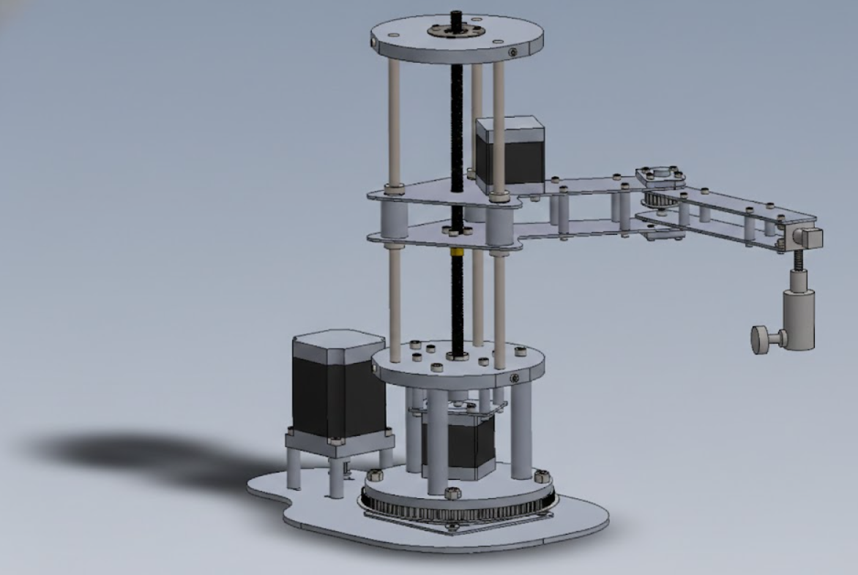
CAD MODEL

Slide 7
STRUCTURAL PARAMETERS
Link Design
Link Geometry:(approx)
Link 1: Length = 140 mm
Link 2: Length = 110 mm
Link 3: Length = 130mm
Link 4: Length = 50mm
Joint Types
Revolute Joints: 3
Prismatic Joints :1

Slide 8
DEGREE OF FREEDOM
DOF:4
Degrees of Freedom refers to the number of independent motions a robot can perform.
For a writing SCARA robot, it typically includes:
Two rotational degrees of freedom are used to achieve precise planar (X–Y) motion of the arm.
One translational degree of freedom provides vertical (Z-axis) movement for pen up and pen down control.
An additional rotational degree of freedom is used to orient the pen end-effector during writing.
Therefore:
Revolute Joints: 3
Prismatic Joints :1

Slide 9
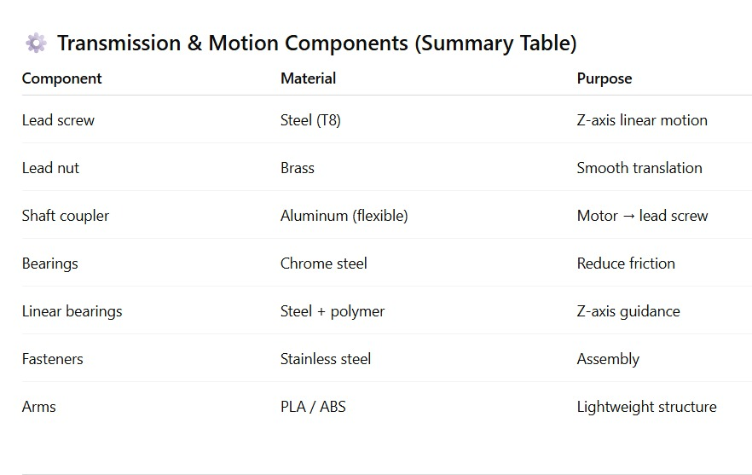
MATERIALS USED

Slide 10
MECHANICAL PARAMETERS
Link weights (approx):
Link 1: 0.20 Kg
Link 2: 0.15 Kg
Link 3: 0.28Kg
Link 4: 0.10 Kg

Slide 11
Torque calculation and motor selection
NEMA 23 torque= 1.2-3.0N.m
MG90s Metal-Gear Servo torque=~0.22N.m
MG90 micro servo torque =~0.18 N.m
MG996R torque =0.92-1.08N.m
Total torque=mass*acceleration*distance
Link 1 center of mass assumed at 0.07 m
Link 2 center of mass assumed at 0.195 m
Link 3 center of mass assumed at 0.25 m
Link 4 center of mass assumed at 0.275 m

Slide 12
T1=(0.20*9.81*0.07)+(0.15*9.81*0.195)+(0.28*9.81*0.25)+(0.10*9.81*0.275)
= 0.13734+0.2869425+0.6867+0.269775=1.3808Nm (joint 1 :base)
NEMA 23(30-60 RPM) is used.
T2=(0.15*9.81*0.055)+(0.28*9.81*0.11)+(0.10*9.81*0.135)
=0.0809325+0.302148+0.132435=0.5156Nm (joint 2:elbow)
MG996R(40-50 RPM) is used.
F3=(0.28+0.10)*9.81=3.73N
T3=3.75*0.008(lead screw)/ 2pi*0.35=0.0135Nm (joint3:Z/vertical)
MG90s Metal-Gear Servo(10-20 RPM) is used.
T4<0.05N, (joint 4:wrist)
MG90 micro servo (80-100 RPM) is used

Slide 13
POWER REQUIREMENT
Input: 230 V AC
Power Supply Unit:
Laptop Adapter:19V DC,5A
Output 1: 19 V DC, 5 A (stepper motor via TB6600 )
Output 2: 5V DC, 5 A (servo motors via DC-DC Buck Converter)
Total power rating: ≥100 W
Regulation: ±5%
Type: DC–DC buck converter: 19V → 5V, 5 A

Slide 14
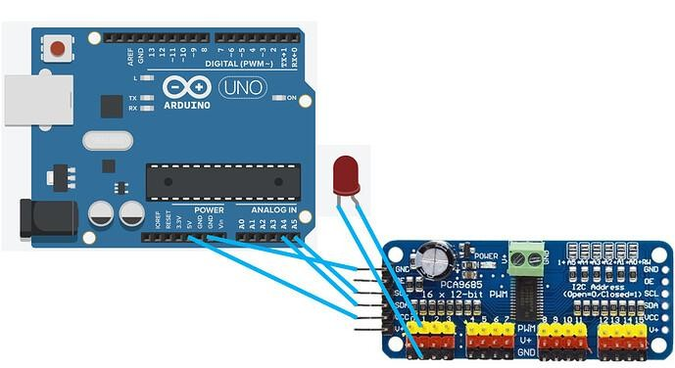
Control System
The SCARA robot is controlled using an Arduino board that generates motion commands for all actuators.
A NEMA 23 stepper motor with a TB6600 driver is used for precise and stable base rotation.
The remaining joints are driven by servo motors controlled through a PCA9685 servo driver for synchronized motion.
An external regulated power supply provides stable power to the motors and drivers.
This setup enables smooth, accurate, and repeatable writing and drawing operations.

Slide 15
DETAILS OF COST INVOLVED
Arduino UNO - 254
NEMA 23 stepper motor-1625
MG90s Metal-Gear Servo motor -118
MG90 micro servo motor-125
MG996R motor-300
TB6600 stepper motor driver-395
PCA9685 servo driver module-229
Lead screw and nut-762
DC–DC buck converter-195
6.35*8mm flexible shaft coupling -55
Forex sheet-305
Miscelleneous-519
TOTAL COST:4882

